Slide 1
Lab 2 – Xamarin Framework
Mr. Yousif Garabet Arshak
Computer Science Department
University of Zakho
yousif.arshak@uoz.edu.krd

Slide 2
Outlines
Create a new application using Xamarin Framework
Syntax of C# if Statement
Syntax of C# Nested If-Else Statement
C# For & Foreach Loop
Array
Any Questions?

Slide 3
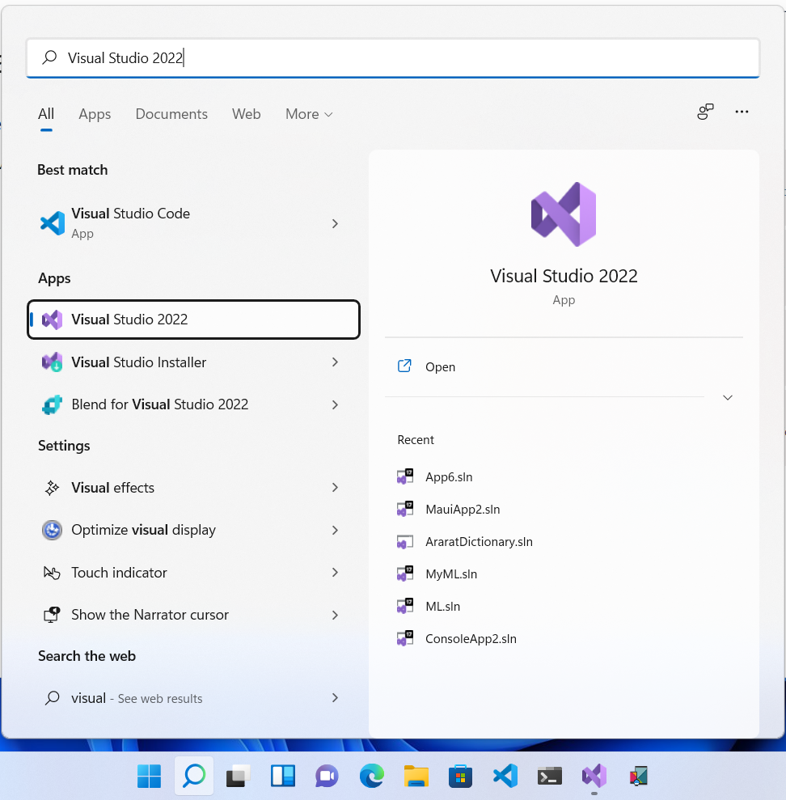
Create a new application using Xamarin Framework
Step1: Open Visual Studio

Slide 4
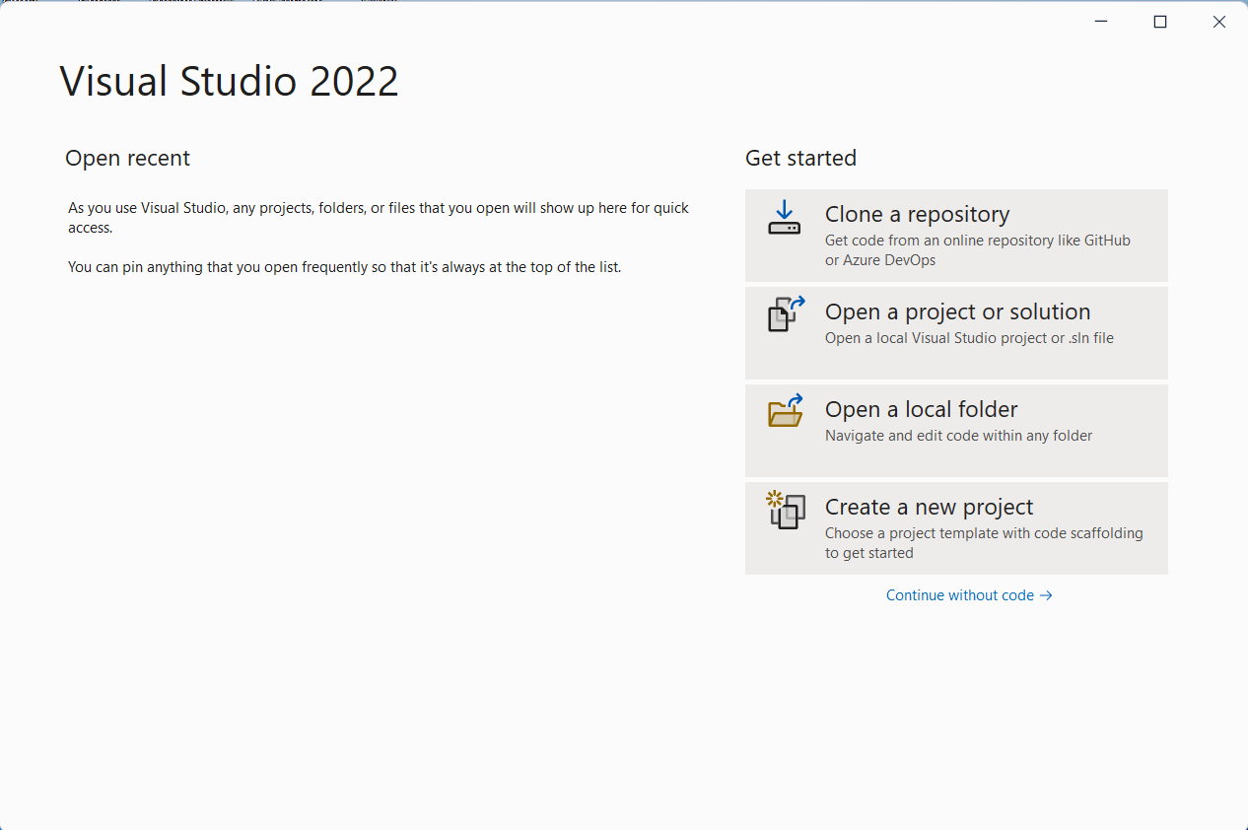
Step 2: Choose Create a new project

Slide 5
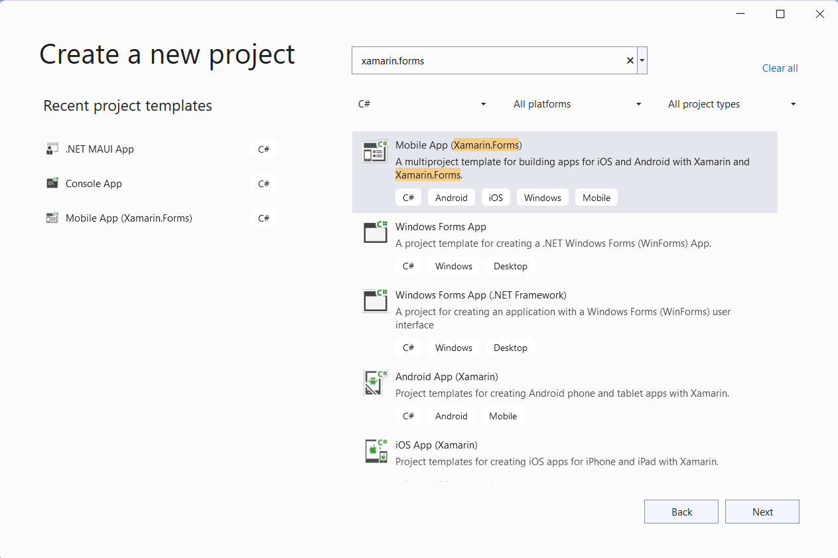
Step 3: Search for Xamarin.Forms

Slide 6
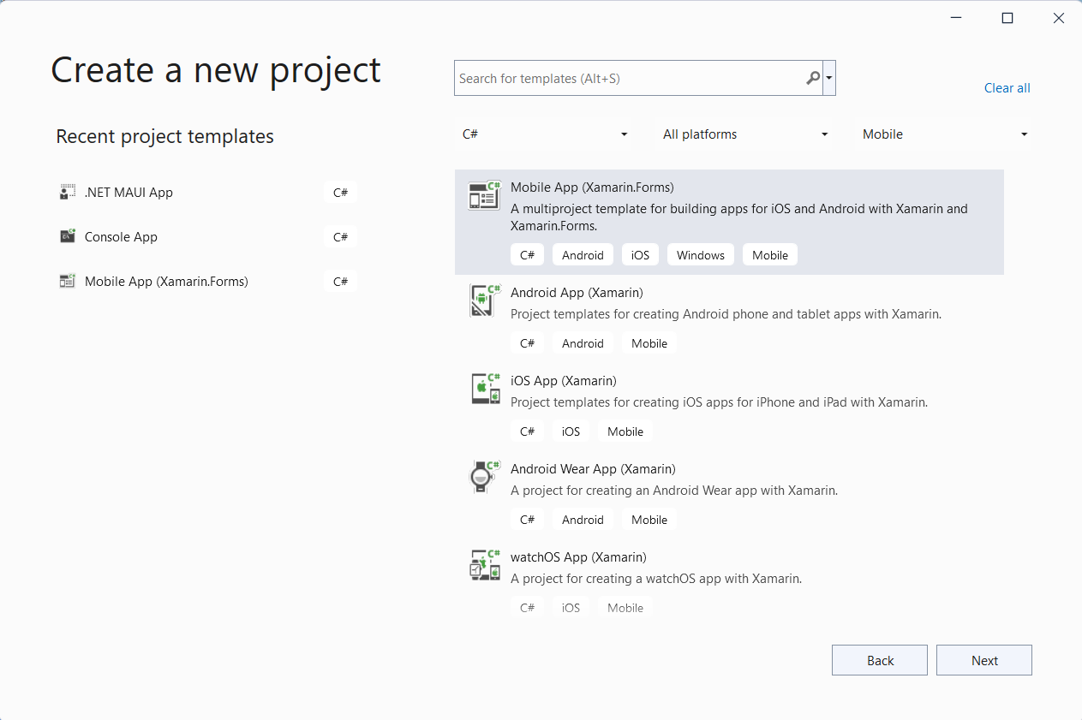
Or you can change project type to Mobile and Language to C#

Slide 7
Step 4: Choose a template for your project and click on Next
In our case we will choose Mobile App (Xamarin.Forms)

Slide 8
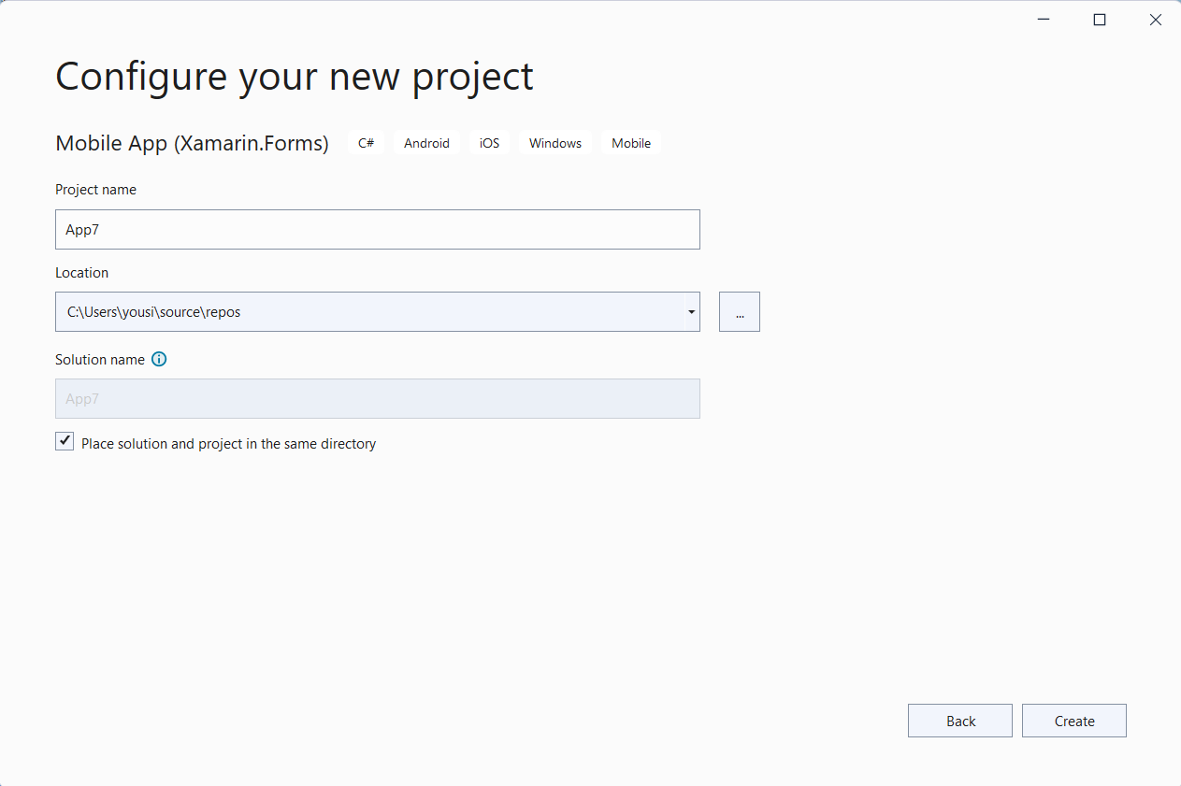
Step 5: Configure your new project
Give a name to your project
Select location where your project will be saved
Select if you want to put project Solution and Project Files in the same Folder

Slide 9
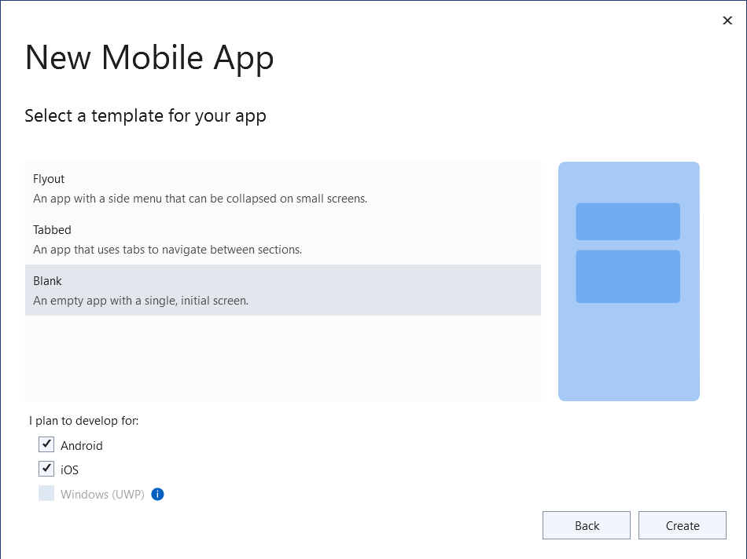
Step 6: Select a template for your application
In this application we will select Blank template
Choose android and iOS to have 2 application with single code base.
We can’t choose Windows (UWP) because I have not installed C++ on my laptop

Slide 10
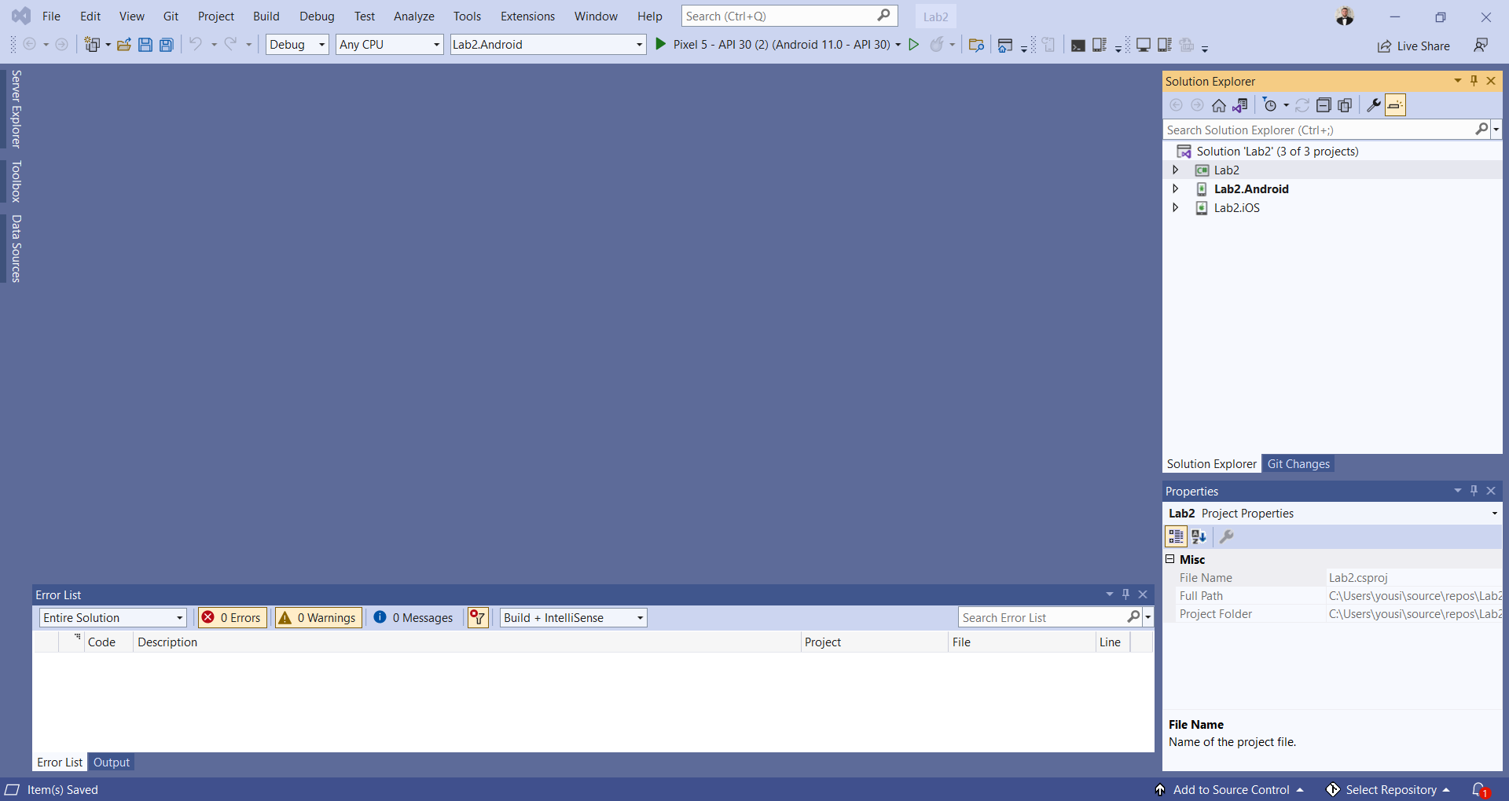
Congratulations you created first project with Xamarin.Forms to create Android and iOS Applications

Slide 11
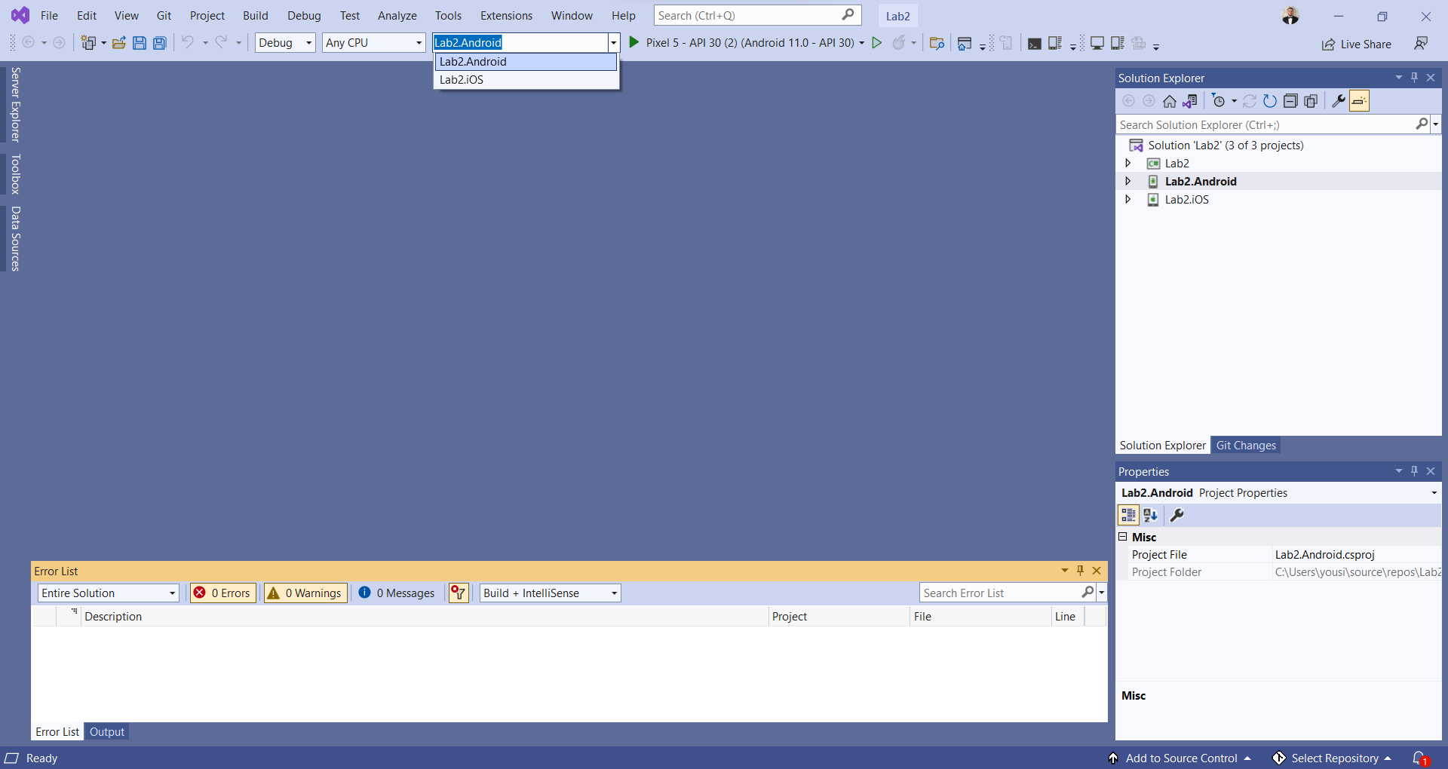
Select Android or iOS to run it in to an emulator

Slide 12
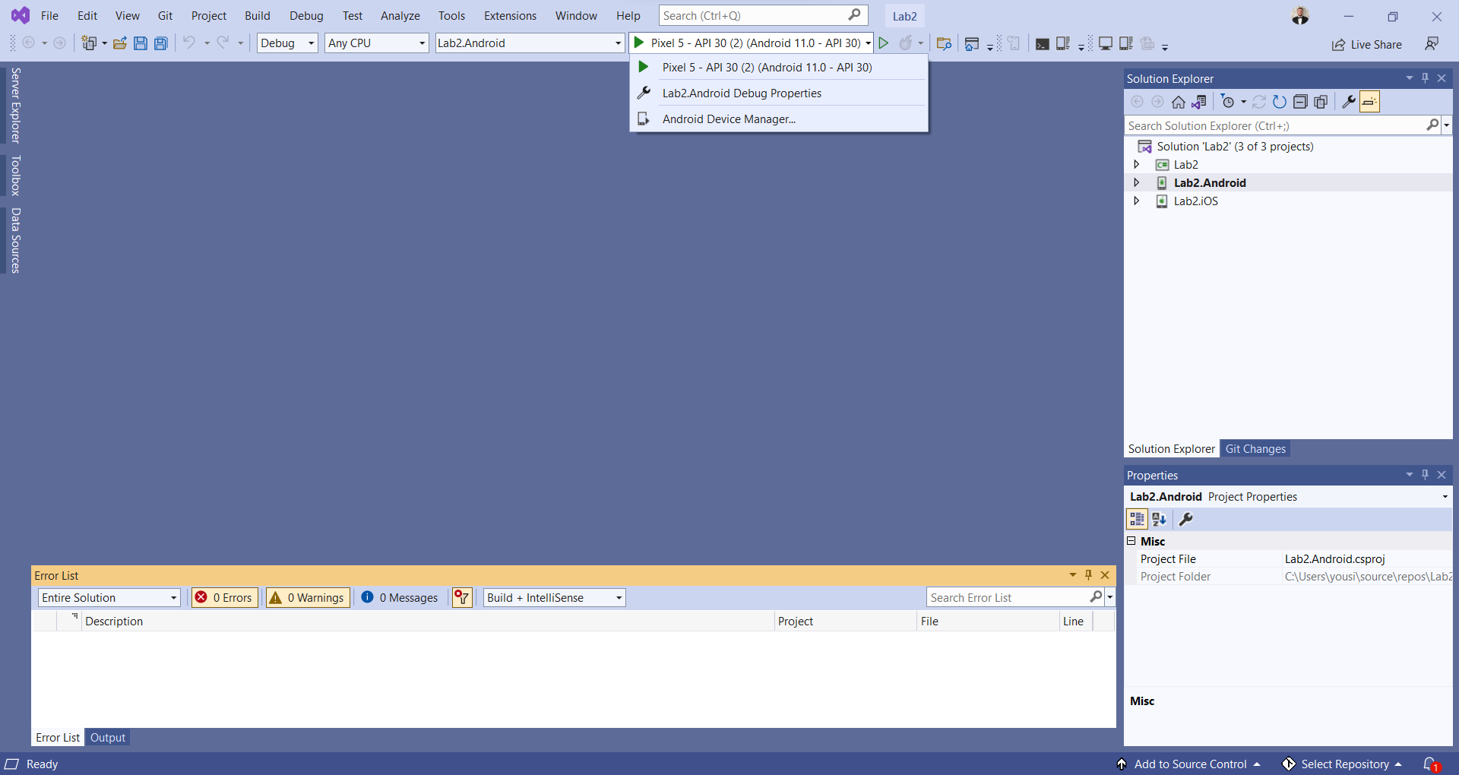
Select the Emulator that you want to run your application on it,
You should have at least one Android API or if you are working on Mac OS you can find iOS Emulator listed here to run your iOS application on it,
For our case we are working on windows OS that is why we can only see Android Emulator.
You can run iOS App from windows Device if you have Physical iOS device with Apple developer account

Slide 13
If you can’t find the correct emulator
Click on Android Device Manager (ADM)

Slide 14
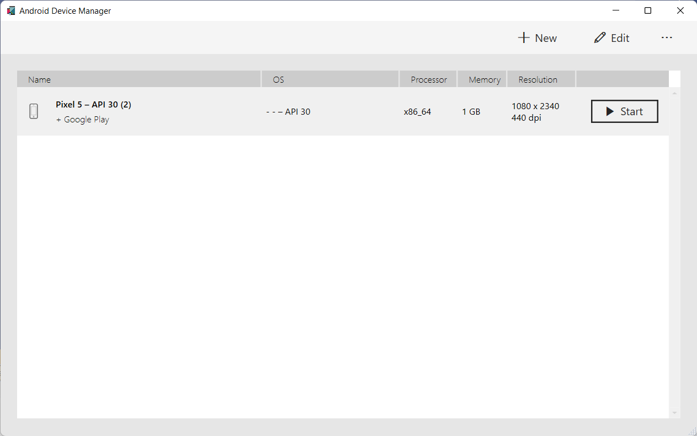
Click here to create a new Android Emulator
Here you will the list of emulators that are installed on your laptop

Slide 15
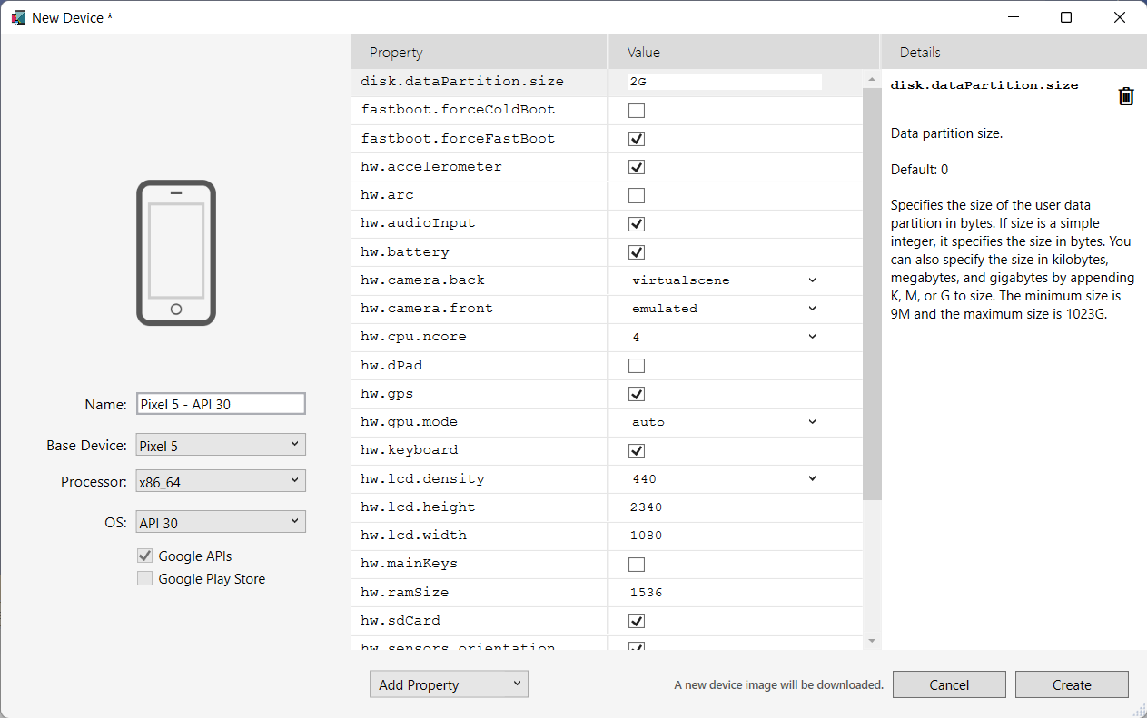
Type a name for your Emulator
Select a device Emulator Base
Select a processor to the Emulator
Select API version for the Emulator
Keep these options default

Slide 16
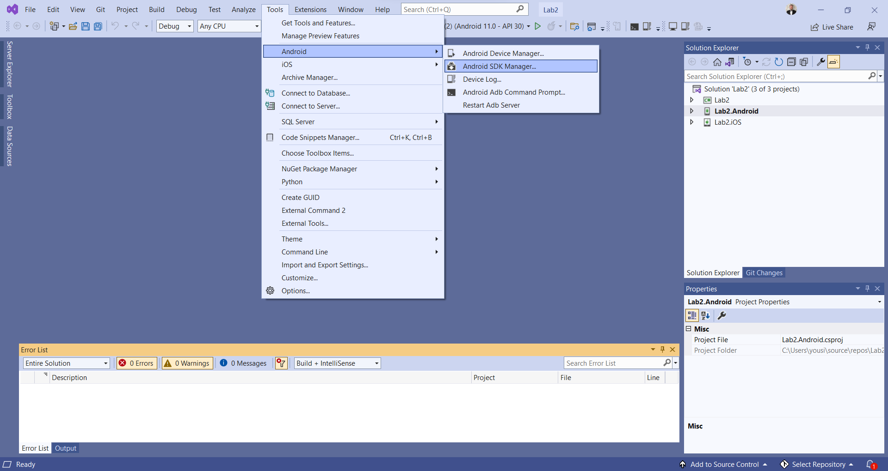
Open Android SDK manager to download the missing Android SDK and System Images for Android Smartphone, Wear OS, Android TV

Slide 17
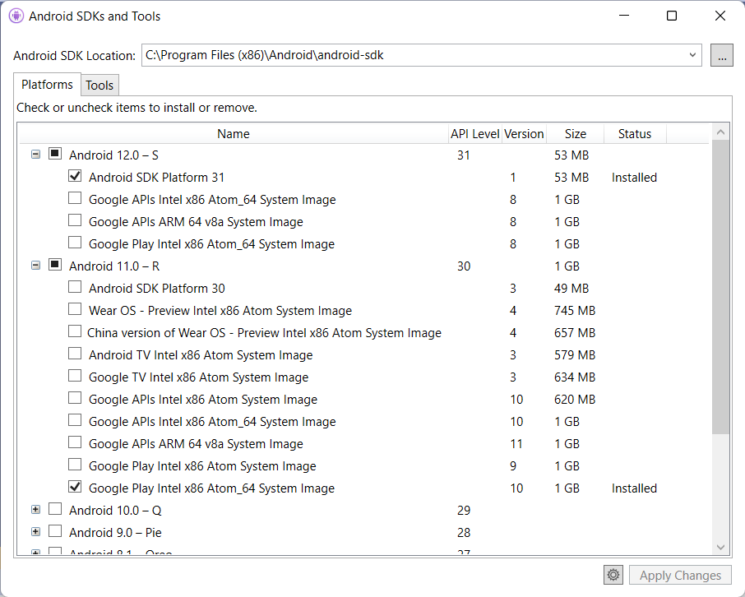
You will need at least to install one Android SDK (installed the latest SDK)
Android SDK 31 is the latest one until the time of making this Lecture
You will need at least to install one Android SDK (installed the latest SDK)
Android SDK 31 is the latest one until the time of making this Lecture

Slide 18
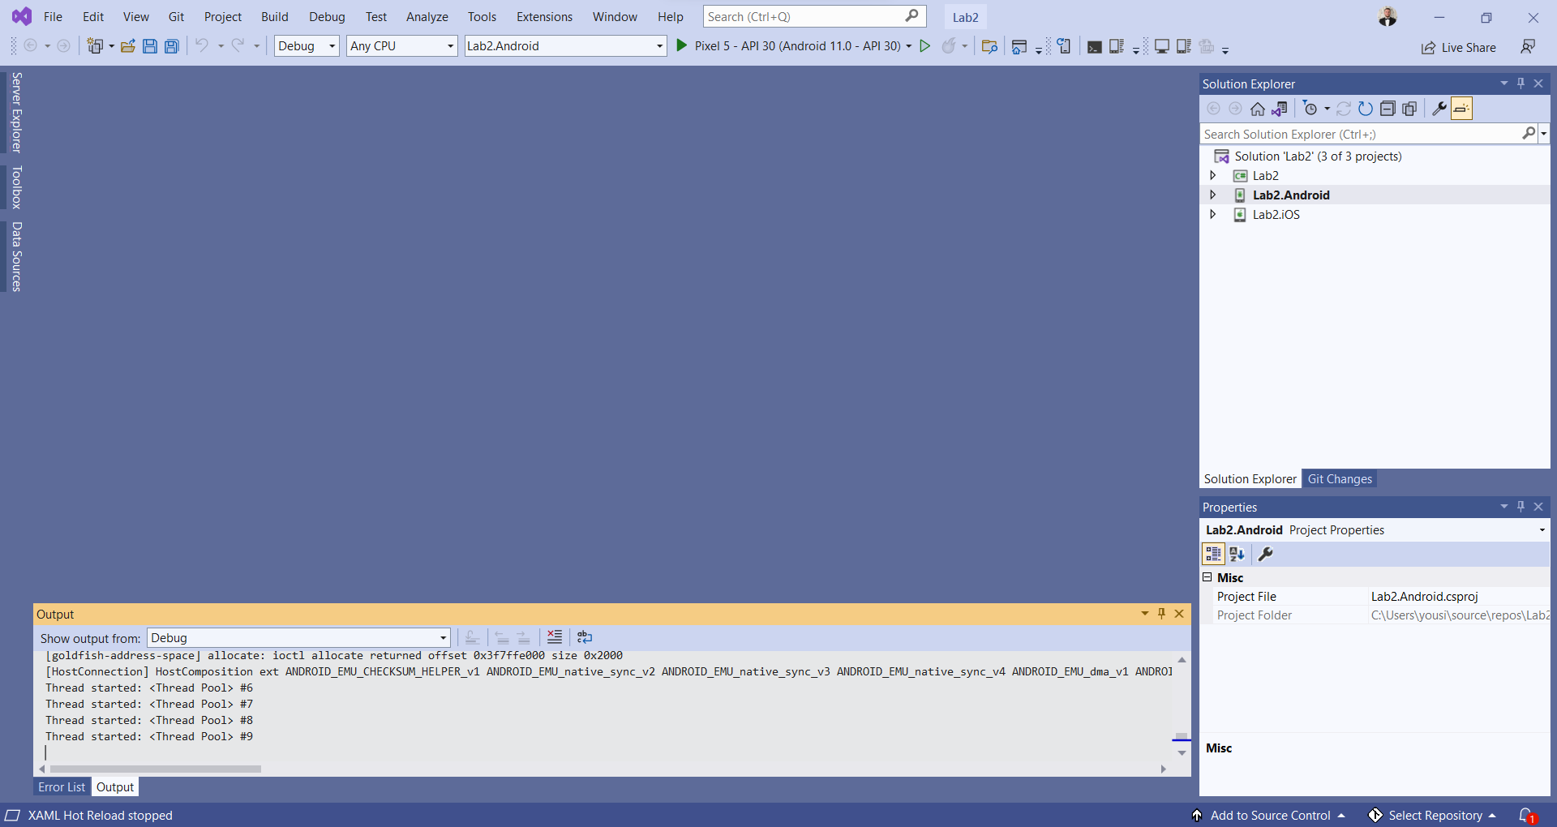
After downloading and installing all the required API, SDK and creating an Emulator now lets click on run our application

Slide 19
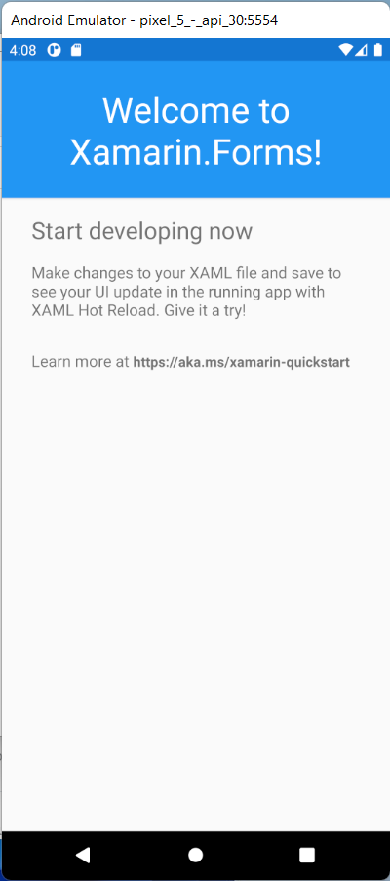
Congratulations! you have run successfully your application on the Android Emulator

Slide 20

Any Questions?

